Slide 1
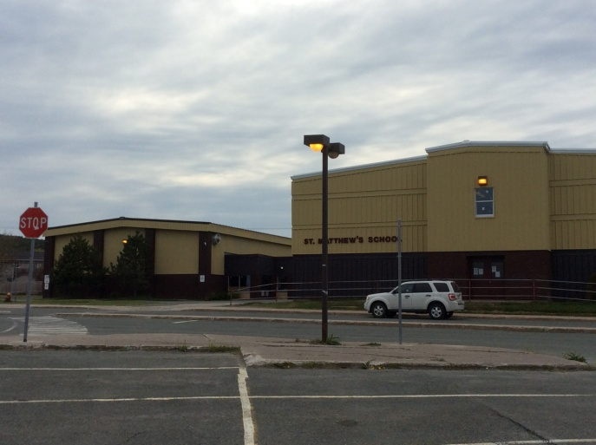
“Shapes of Strength”
An Inquiry Based Project
Grades 1 & 3
STEM Project
St. Matthew’s School
St. John’s, NL
2015-2016

Slide 2
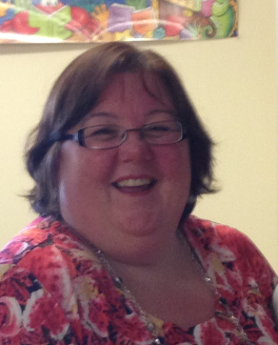
Mrs. Danielle Bishop
I have been teaching for 20 years and have had a wide range of teaching assignments from Kindergarten to Grade 5 as well as two Assistant Principal positions. I am currently teaching Grade 3 English at St. Matthew’s School with a class of 19 students (5 girls and 14 boys) of varying interests and abilities.
After such a fantastic learning experience with STEM last year. We had decided to reapply for a second year. I was thrilled when our application was approved. I knew this would be another fantastic opportunity to improve my teaching and student learning and achievement. Once again STEM was a fabulous learning experience!

Slide 3
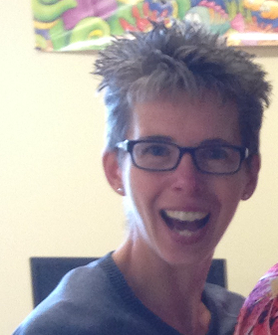
Ms. Nancy Ryan
I am presently teaching Grade 3. I have 21 students – 7 girls and 14 boys. This is my second year participating with Teachers In Action. Once again, I have been involved with the creation and implementation of this year’s project with some great colleagues. Bringing inquiry based teaching and learning into my classroom has been a very positive experience for both myself and my students. Interest, intrigue, motivation and collaboration transpire among the children. We are teaching and learning across the curriculum in an authentic and natural way. I have learned a lot about the engineering design process through this project.

Slide 4
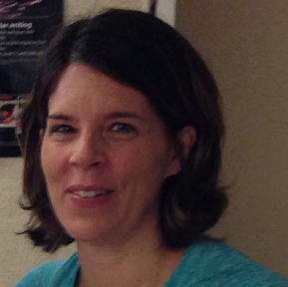
Ms. Valerie Hodder
This is my 9th year teaching grade one at St. Matthew's School. I have 13 children in my class this year (6 girls and 7 boys) and it is my first year participating in the STEM project. I have thoroughly enjoyed watching my children engaged in hands on activities and “I Wonder” projects. It has been a very rewarding experience for all of us.

Slide 5
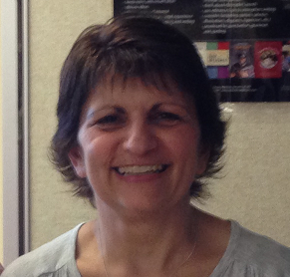
Mde. Marlene Audeau - Joyce
I have been teaching for over 20 years, including substitute time. Over the past 16 years, I have taught Grade 1 in both the French and English stream and Grade 3 French Immersion. I am currently teaching Grade 1 French Immersion at St. Matthew’s School with a class of 22 – 12 girls and 10 boys. This is my second year being involved with the STEM project. I have thoroughly enjoyed watching the children immersed and engaged in the activities we have done.

Slide 6
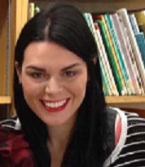
Ms. Ashley Vincent
I am currently teaching Grade 3 , Grade 5 and IRT at St. Matthew’s School. I have 12 students in Grade 3 and 17 students in Grade 5. This is my first year participating in the STEM program . Including substitute time I have been teaching for six years. I have substituted in every grade and taught Grade 1 French Immersion twice, Grade 2 French Immersion and Grade 6 French Immersion.
After returning back to work from a one year maternity leave, I was approached by Danielle and Nancy to be a partner in this STEM project. At first, I was oblivious as to what this would entail. I was both nervous and excited to take on a new endeavour in my career. This has been the most influential year of my life, I have gained so much insight into myself as a teacher and who my students are as learners. I am so happy I decided to take this journey with so many lovely teachers.

Slide 7
Project Background
Danielle, Marlene and Nancy completed a TIA project last year. We investigated plant development from seed to plate to compost in an outdoor environment.
The students were actively engaged and self-motivated. Our classrooms transformed into student centered learning environments. It was an immensely rewarding learning experience for all!
Danielle, Marlene, Nancy and Val completed a STEM proposal in May 2015 to look more specifically at the 5E Cycle strategy of scientific inquiry. We decided to link a mathematics unit with science. Ashley joined our team in September 2015.

Slide 8
Project Focus and Rationale
Using the 5E Cycle strategy of scientific inquiry, teachers and students will investigate the properties of geometric shapes and solids and their connections to structures in their world.
Students will be involved in inquiry-based activities as they explore the properties of geometric shapes and solids. They will design, build, and test structures. Students will also explore trade books to support their investigations of how shapes and solids are used in various structures in their environment. Students will gain an increased understanding into both human build and natural structures in their world.

Slide 9
Research Questions
Our Teacher Research Question :
How do I teach primary students to think and learn like engineers?
Other Considerations:
→ What is the 5E Cycle? → What is engineering technology? → What is the EDP – Engineering Design Process?

Slide 10
Research Questions
Our Student Research Question:
How will inquiry based learning in engineering technology affect students’ ability to make connections to the real world?

Slide 11
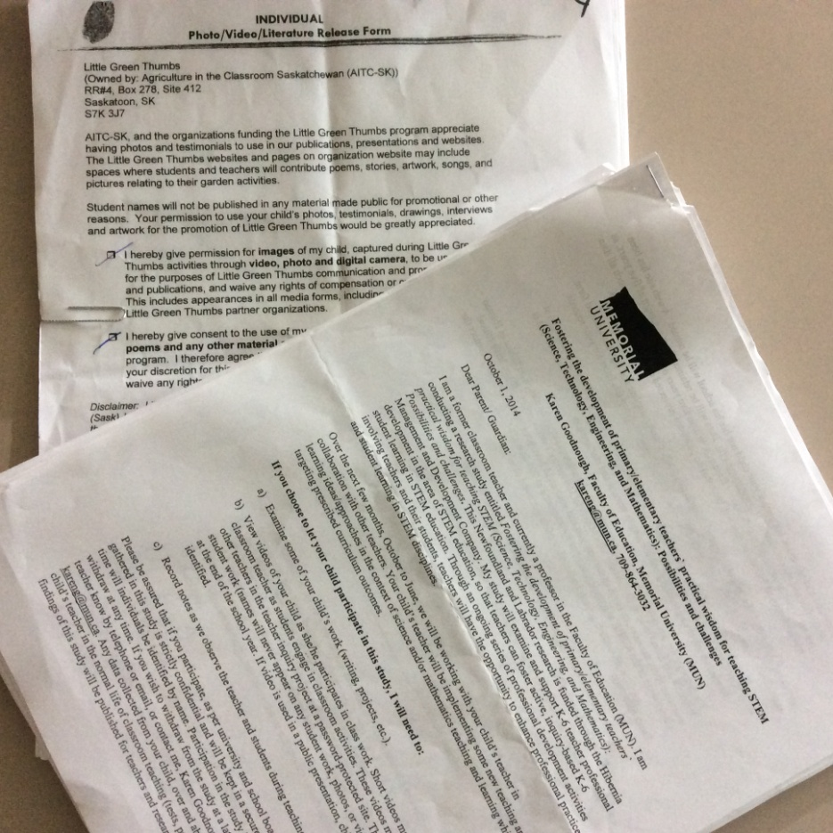
Ethical Considerations
Families were informed of this research project.
Two consent forms were sent home to obtain parental consent for this research project – one from Memorial University of Newfoundland and one from St. Matthew’s School.

Slide 12
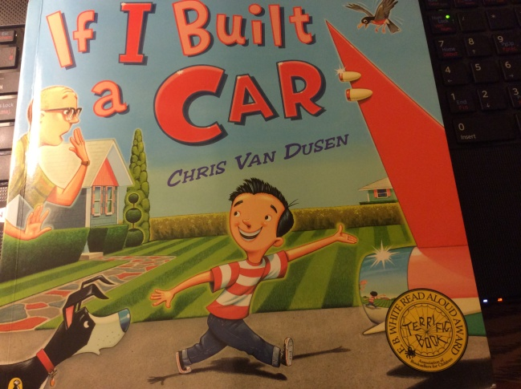
Planning
We read and discussed a wide variety of professional literature. We subscribed to Science and Children journal from NSTA.
We selected and purchased a variety of science, math and engineering children's literature.
Release days were held throughout the project with support and guidance from Mr. Tom Walsh.
We met to share, plan, design, create, and prepare lessons, activities and design challenges. We collected and created resources, materials and needed supplies. We reviewed, discussed and reflected upon our individual classroom experiences using Evernote.

Slide 13
Planning
We created student pre and post assessments including interviews and vocabulary inventories.
We involved students in “I Wonder” inquiry based activities as a “warm up” to our project.

Slide 14
5 E Cycle
Engage
Explore
Explain
Elaborate
Evaluate
This is a constructivist based (Piaget, Gardner) teaching framework or sequence that may be used for individual lessons, particular units or entire programs.
Students build their own understanding from personal experiences and new ideas.

Slide 15
5 E Cycle - Engage
The purpose for the ENGAGE stage is to pique student interest and get them personally involved in the lesson, while pre-assessing prior understanding.
At this stage the teacher’s purpose is to create interest and build on the natural curiosity of the students. Students are encouraged to ask questions so as to assess student prior knowledge.
Childrens’ literature can be used as a springboard to engage students.

Slide 16
5 E Cycle - Explore
The purpose for the EXPLORE stage is to get students involved in the topic; providing them with a chance to build their own understanding.
At this stage the teacher’s purpose is to build on their curiosity and provide time and opportunity to problem solve and work through the problem presented.
Emphasis is on questioning, data analysis and critical thinking.

Slide 17
5 E Cycle - Explain
The purpose for the EXPLAIN stage is to provide students with an opportunity to communicate what they have learned so far and figure out what it means.
At this stage the teacher’s purpose is to facilitate communication between students, teacher and students, and to encourage reflection. Teachers may also provide clarification.
This is the stage where students begin to communicate what they have learned.

Slide 18
5 E Cycle - Elaborate
The purpose for the ELABORATE stage is to allow students to use their new knowledge and continue to explore its implications.
At this stage the teacher’s purpose is to remind students of alternative explanations and to remind them to extend the concepts, strategies and skills learned in new situations.
Students make connections to related concepts, expand on concepts they have learned and apply their understandings in new ways.

Slide 19
5 E Cycle - Evaluate
The purpose for the EVALUATION stage is for both students and teachers to determine how much learning and understanding has taken place.
At this stage the teacher’s purpose is to observe the students as they apply the new concepts and skills and assess how their thinking, learning and behaviours have changed.
Students demonstrate their understanding with their models, plans, reports, drawings, journals and videos. Students are excited to share!

Slide 20
The EDP – 5E
Engage
Explore Engineer
Explain
Elaborate
Evaluate
This process involves replacing exploration with engineering design.

Slide 21
The EDP – 5E – Engineer
The purpose for the ENGINEER stage is to structure a lesson in which students engage in engineering design.
At this stage the teacher’s purpose is to present an engineering challenge and to remind them of prior science knowledge. It may be necessary to teach relevant science knowledge.
Students are trying different design solutions to solve the same problem and learning that a second try is an important engineering strategy.

Slide 22
Engineering Design Process (EDP)
Scientists study nature. They perform experiments with the Scientific Method.
Engineers create new things. They use science to solve problems. Engineers follow the creativity – based Engineering Design Process.

Slide 23
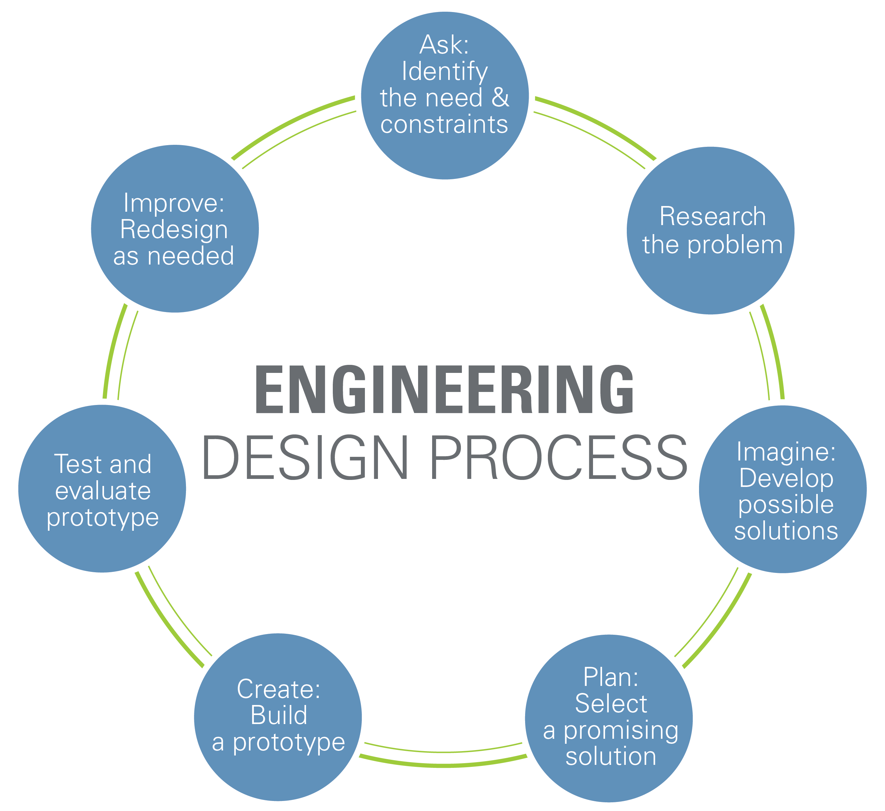
Engineering Design Process (EDP)

Slide 24
Children’s Literature
Children’s Literature is also known as Trade Books.
Children’s Literature can be used to:
introduce a lesson
launch an “I Wonder”
motivate students
elaborate on ideas discovered in a challenge or activity
teach an actual concept
conclude a lesson or topic
consolidate student ideas and understandings

Slide 25
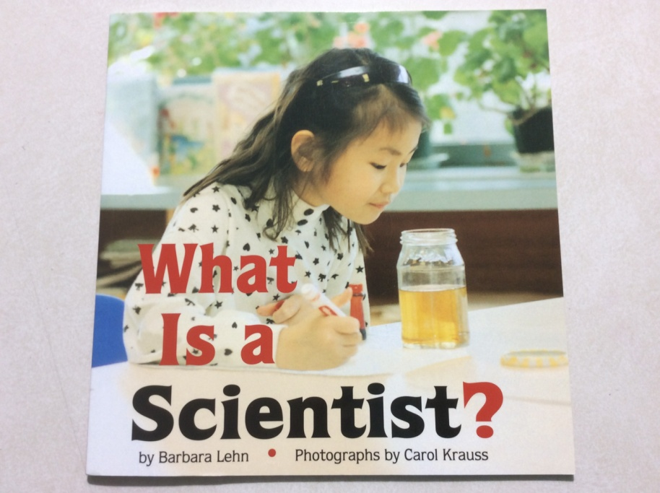
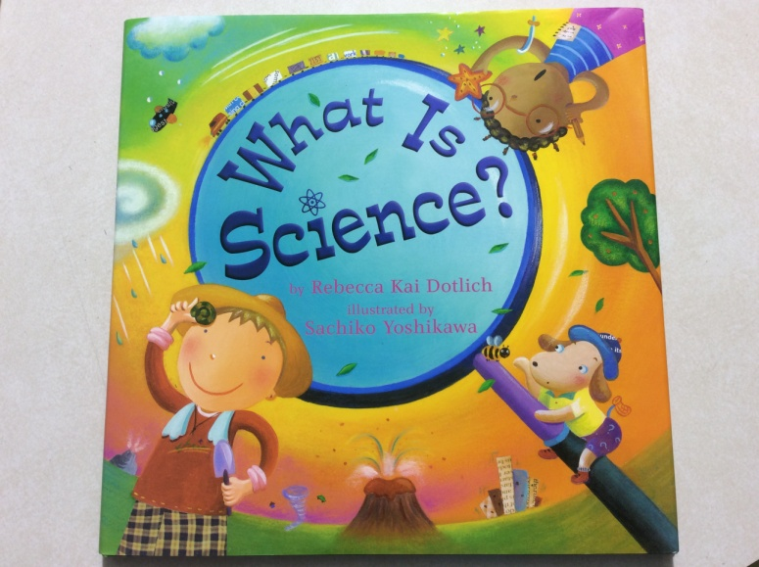
Children’s Literature
Science

Slide 26
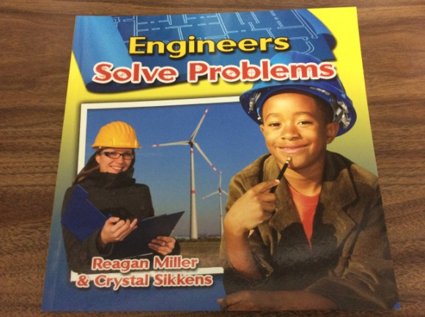
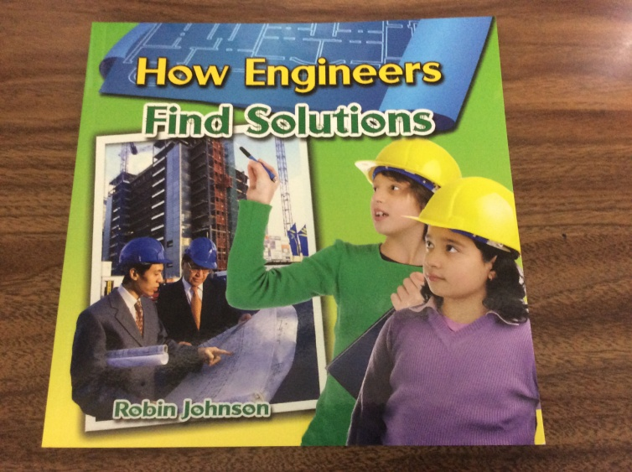
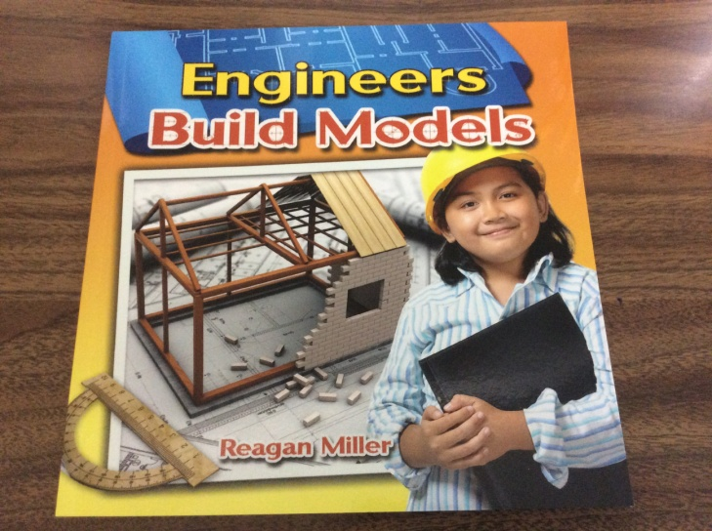
Children’s Literature
Engineer

Slide 27
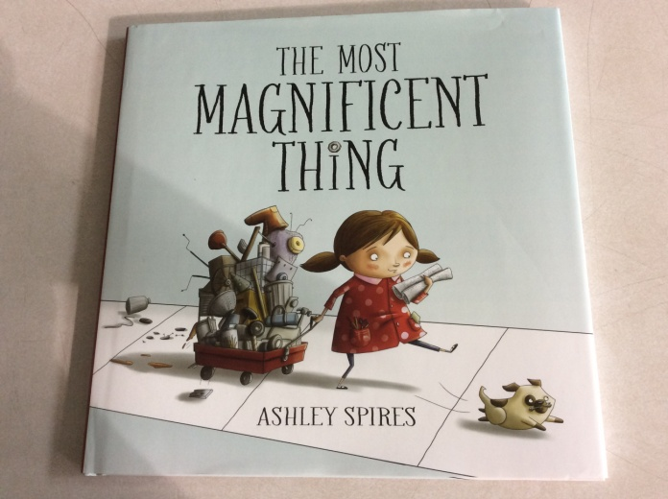
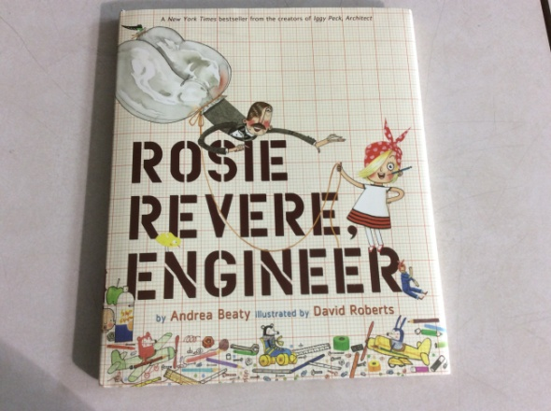
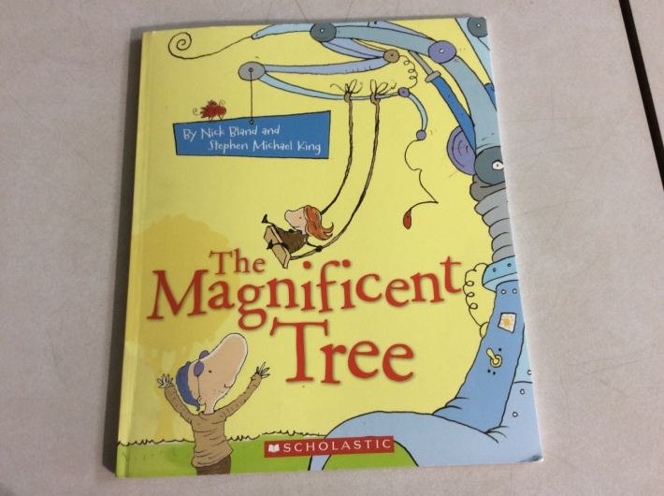
Children’s Literature
Engineer Design Process

Slide 28
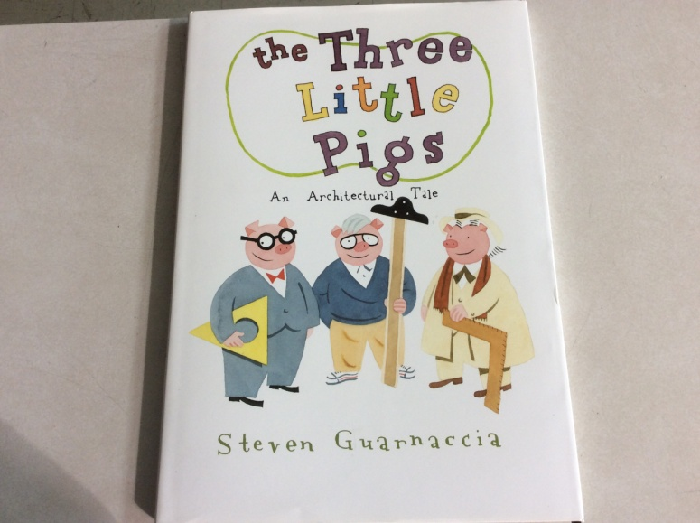
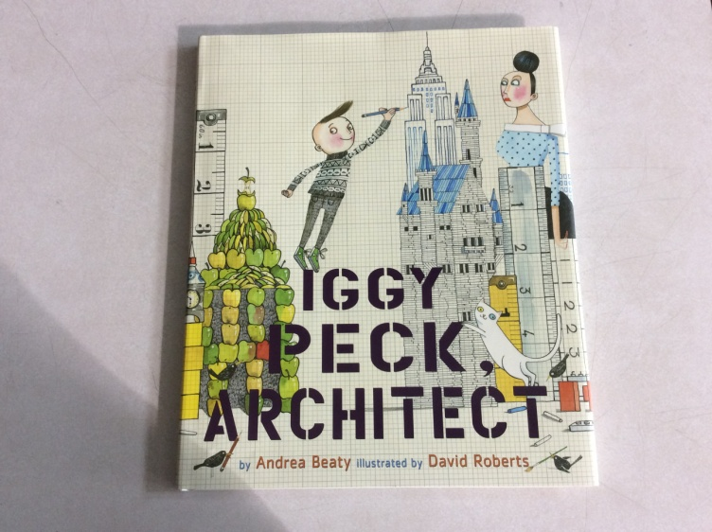
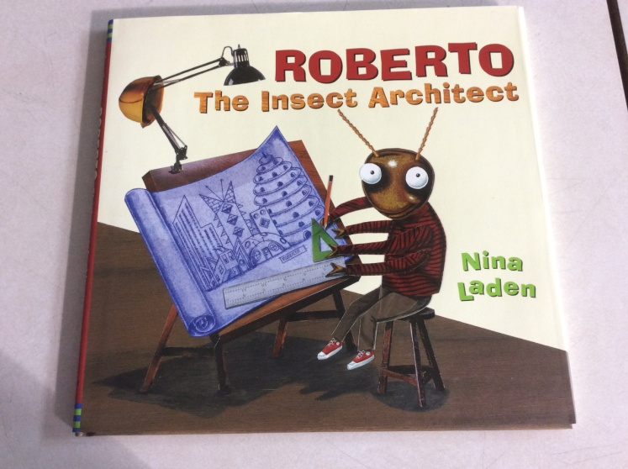
Children’s Literature
Architect

Slide 29
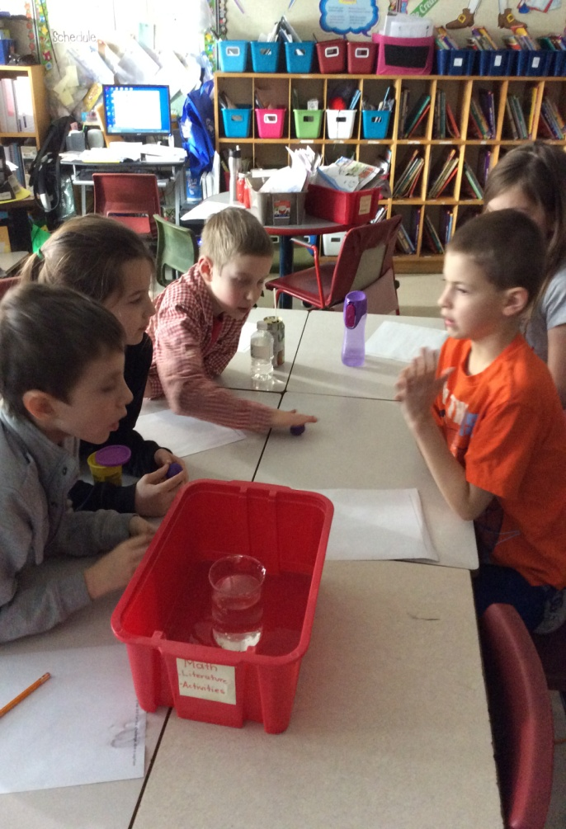
Implementation
Curriculum outcomes from grades 1 and 3 math and science were selected to be the focus of our inquiry based activities and lessons.
Student surveys, vocabulary inventories and interviews were administered to determine students beliefs, feelings and understandings about math and science. Students were asked to represent “What is a scientist?” and “What is an engineer?”. They also drew pictures of their perception of science learning in their classroom.

Slide 30
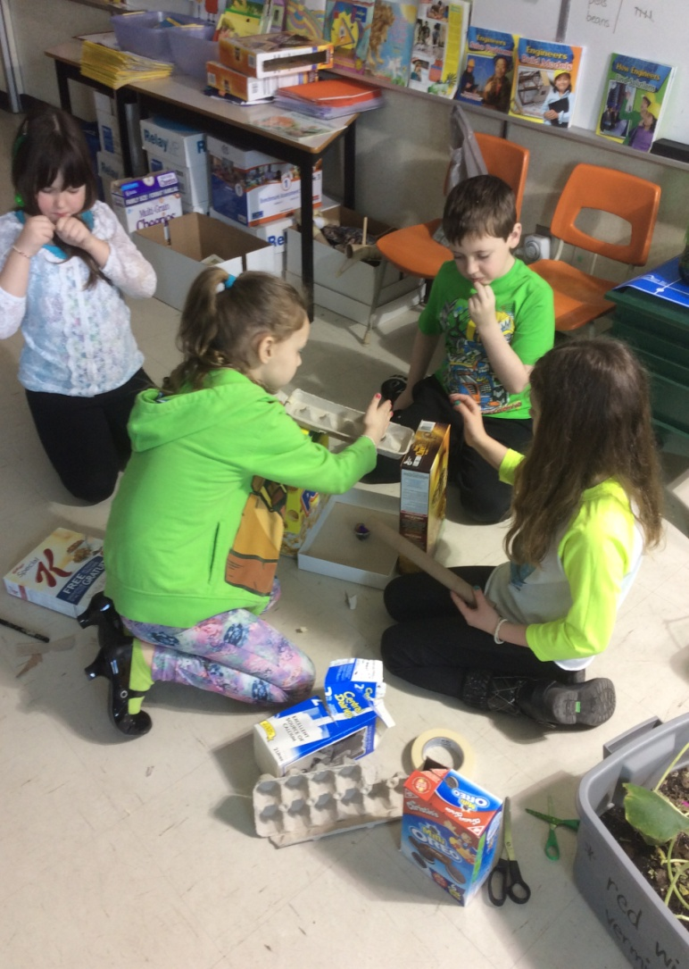
Implementation
This data was collected before and
after our project implementation.
Data was collected from student work samples, classroom observations, videos and photographs (iPad) and their engineering designs and prototypes.

Slide 31
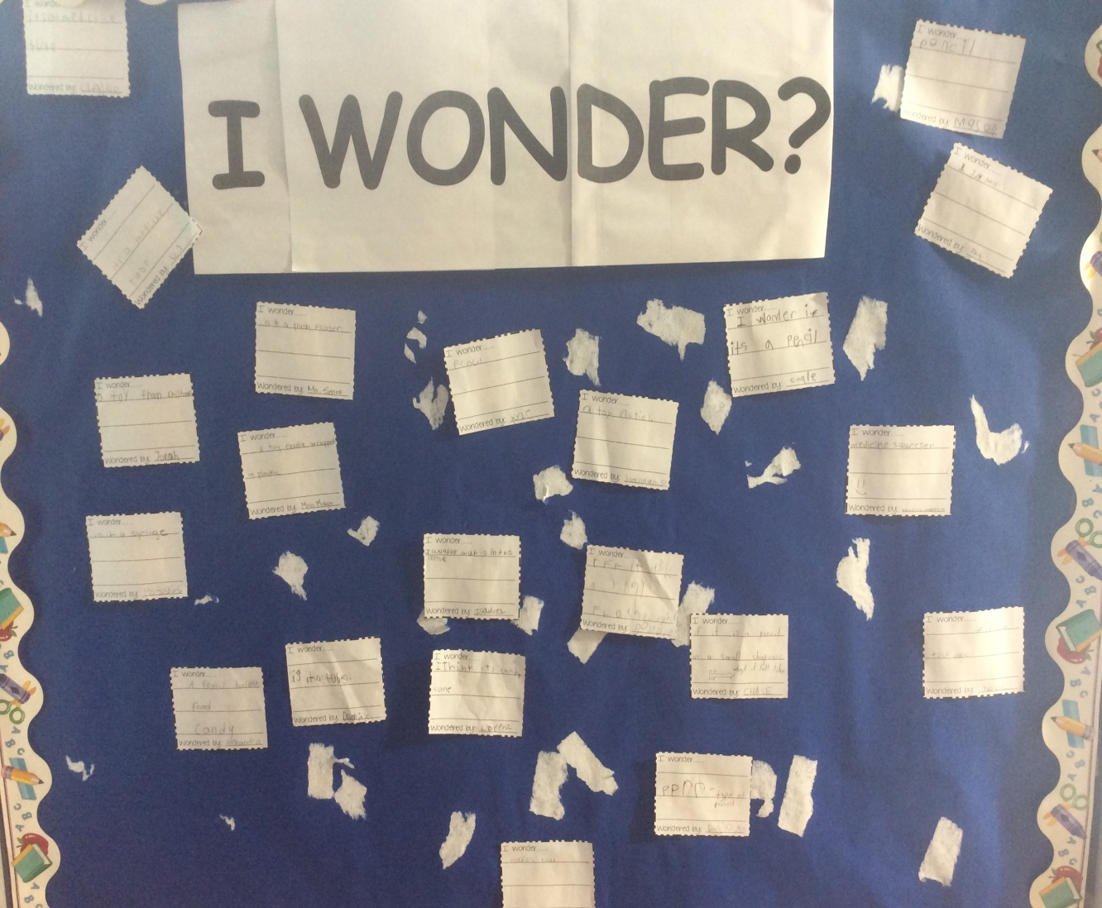
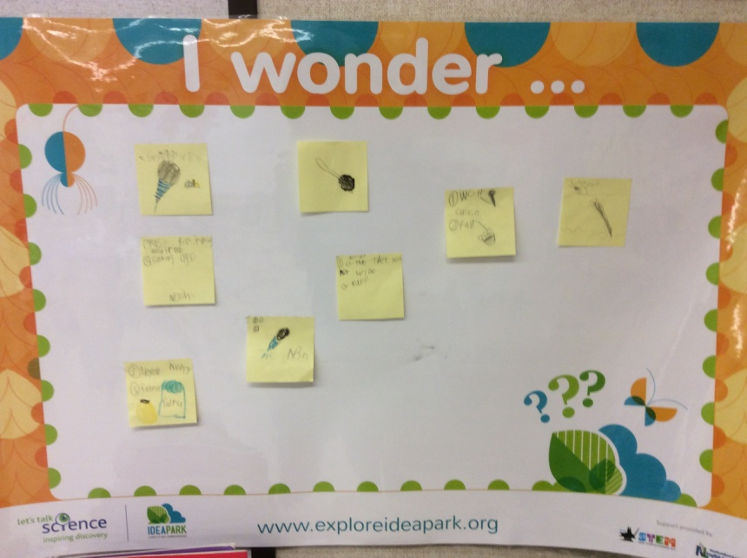
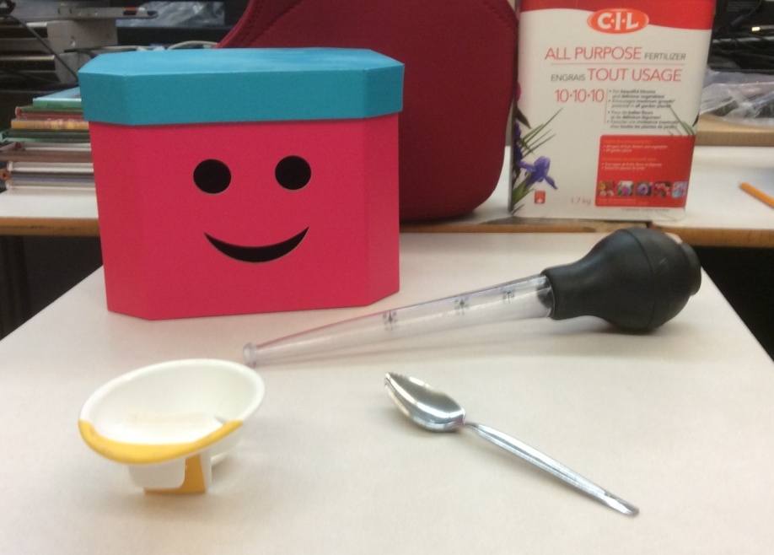
I Wonder????

Slide 32
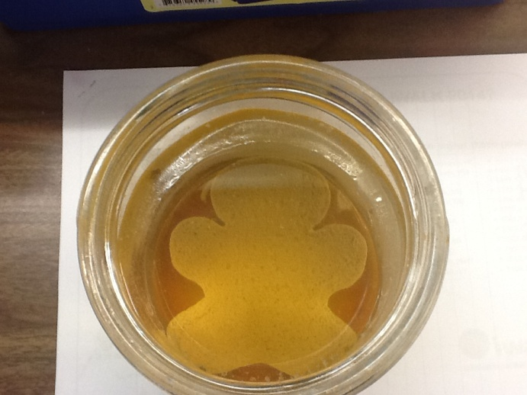
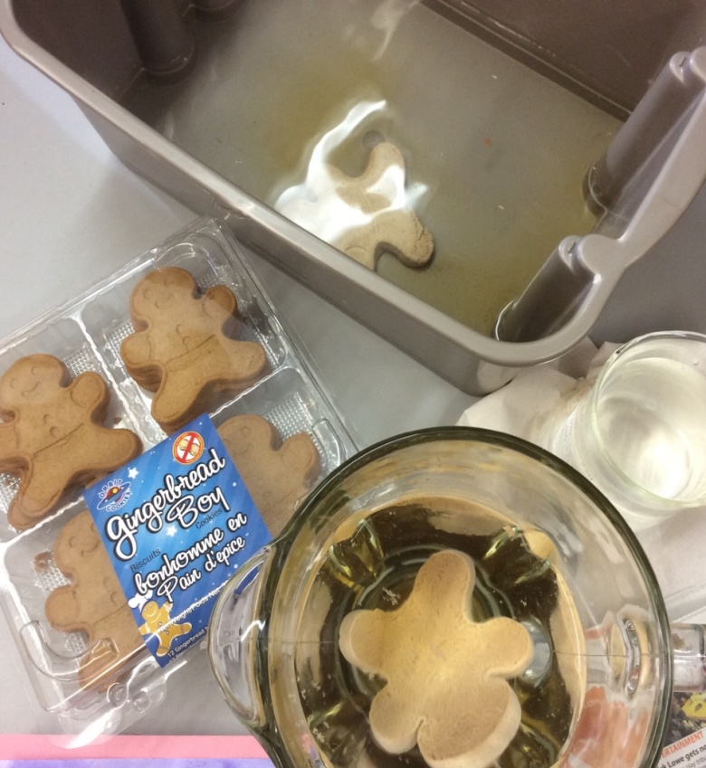
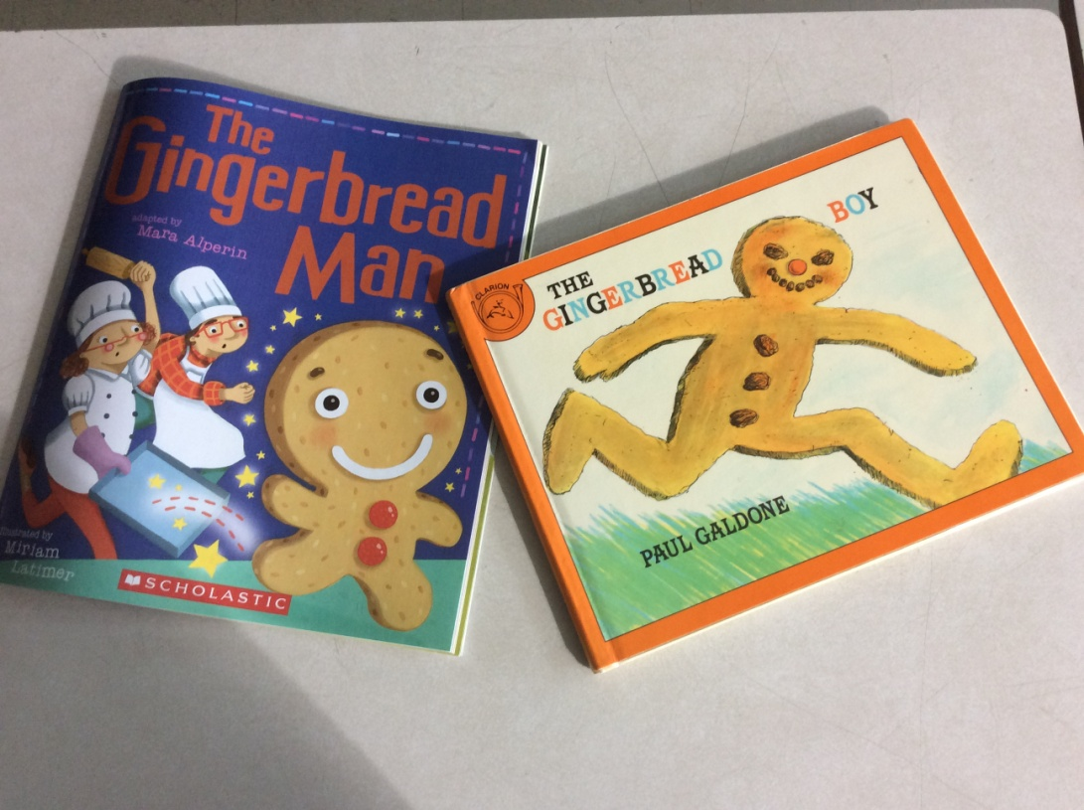
I Wonder????
The Gingerbread Man

Slide 33
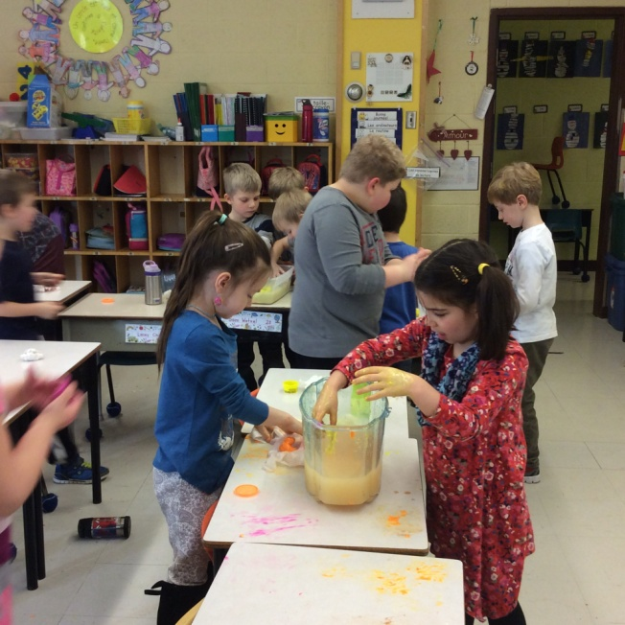
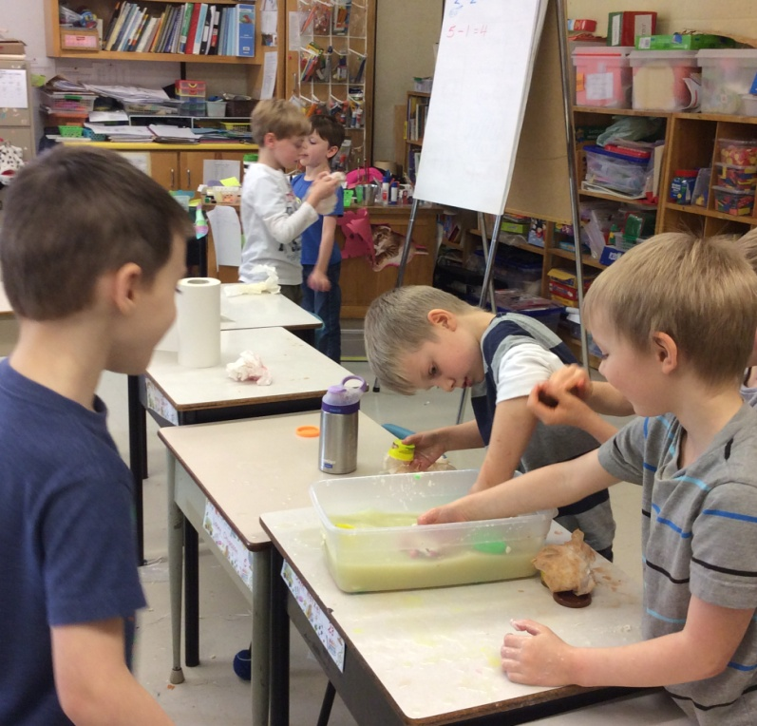
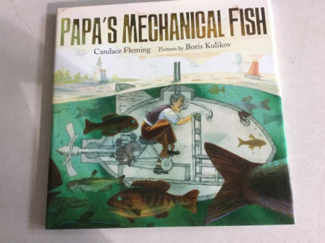
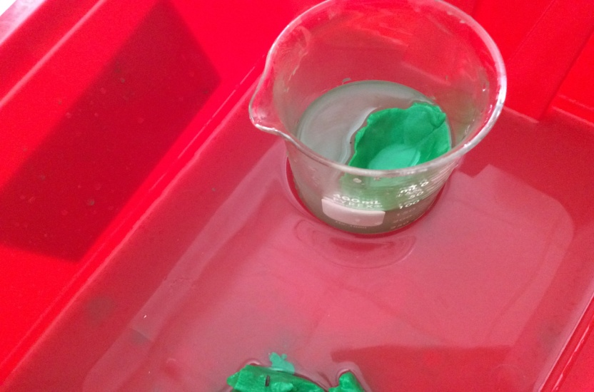
I Wonder????
Floating Playdoh

Slide 34
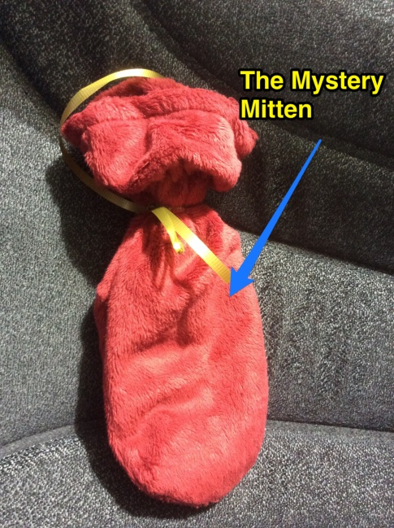
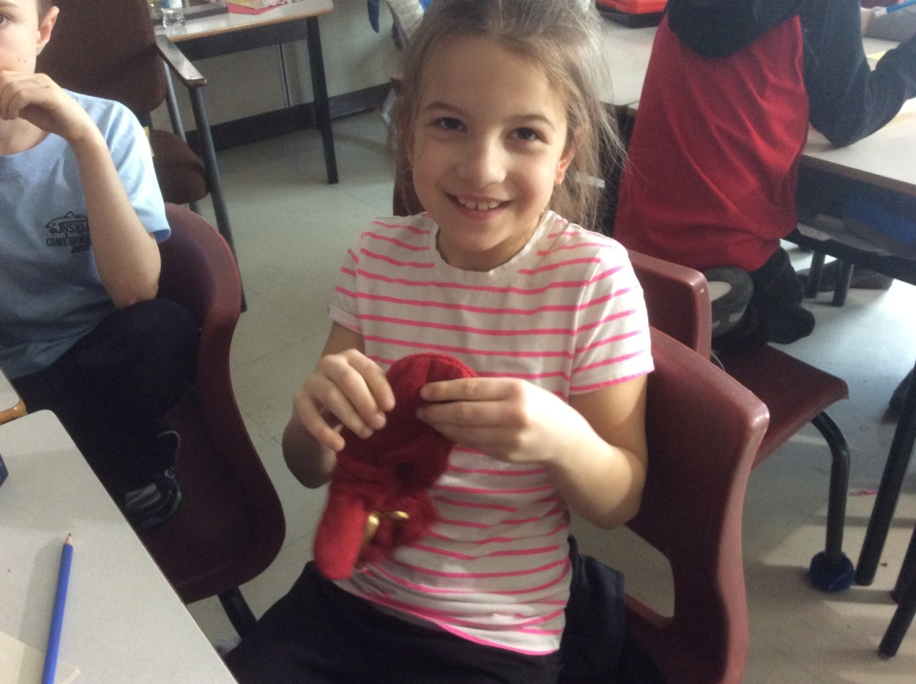
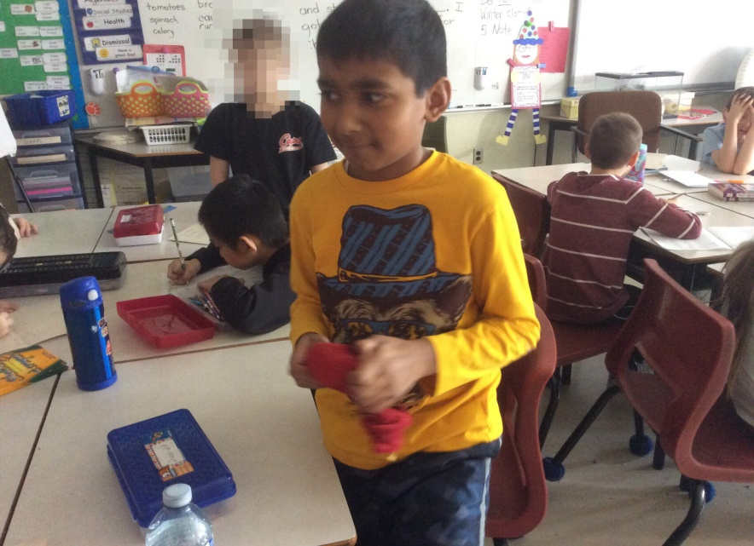
I Wonder????
Mystery Mitten

Slide 35
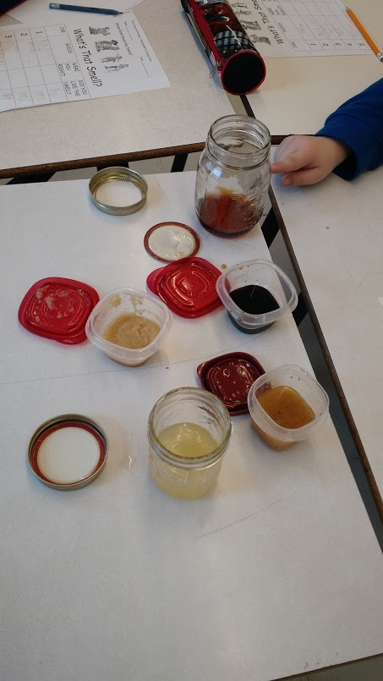
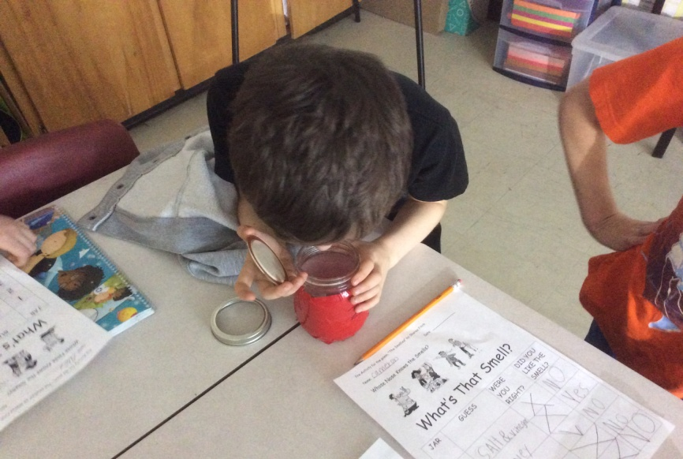
I Wonder????
The Smellies

Slide 36
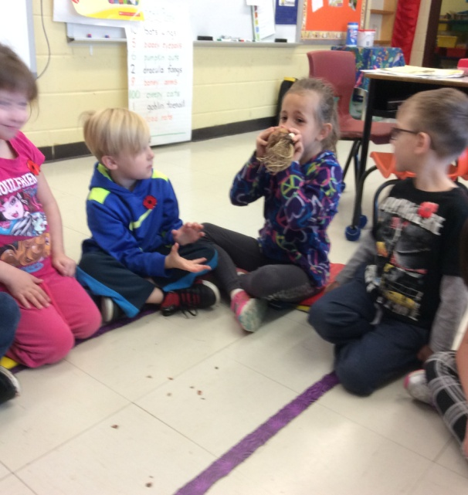
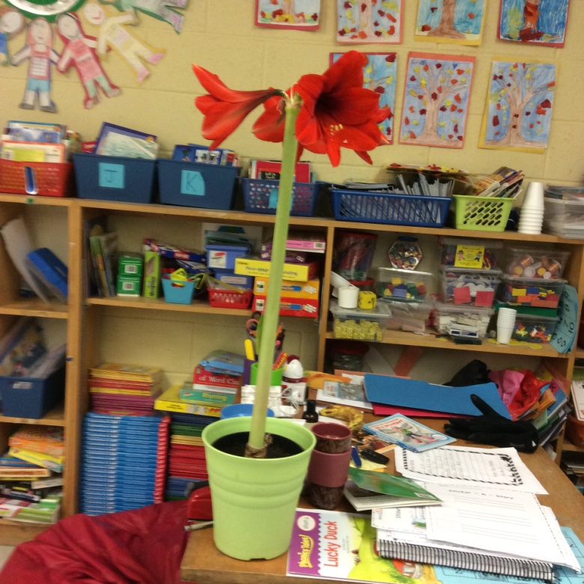
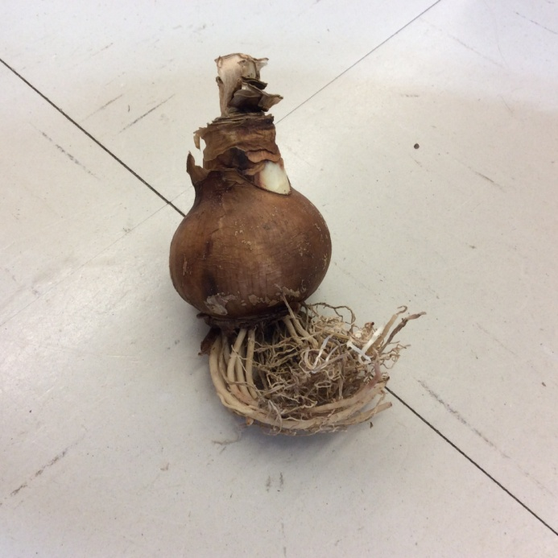
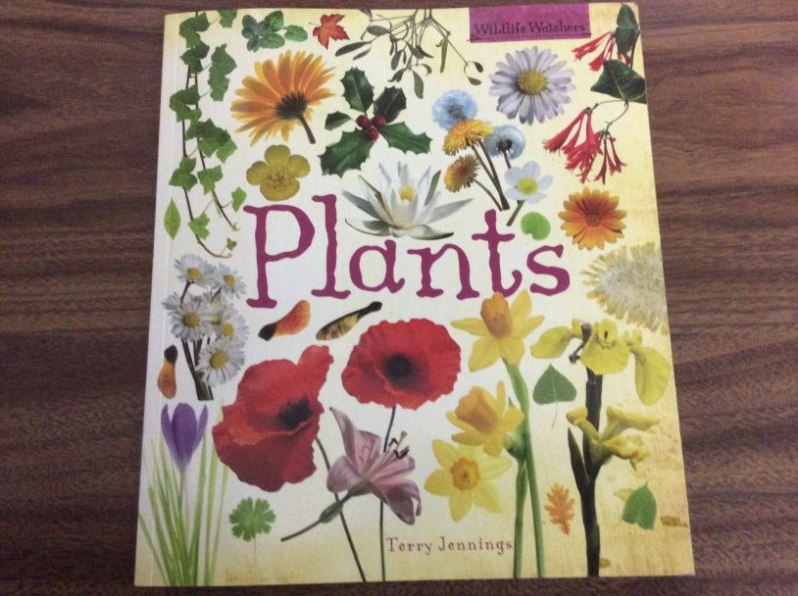
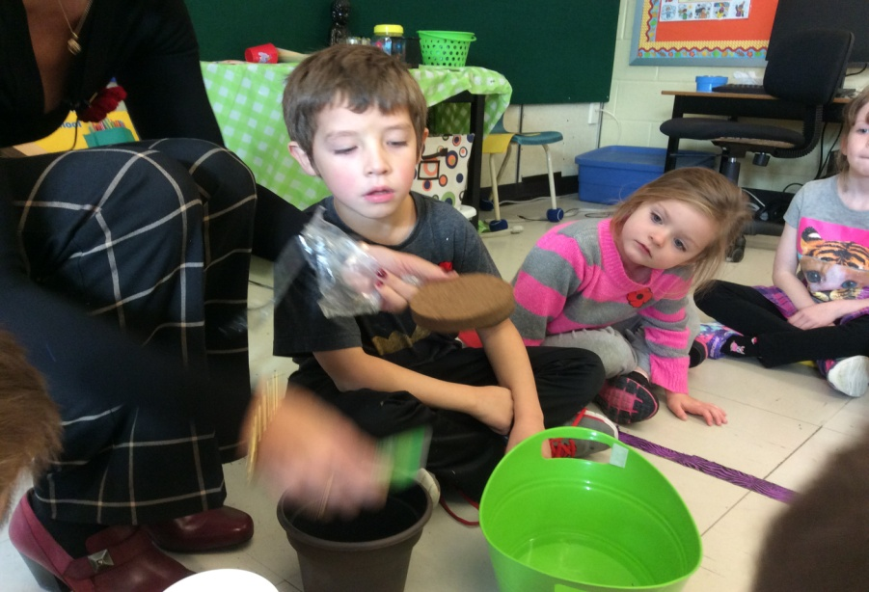
I Wonder????
Amaryllis

Slide 37
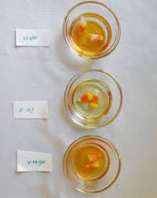
I Wonder????
Candy Corn
The students thought.........
“The candy will disappear”
“The candy will explode!”
“The candy will break down!”
“It will make another candy!”

Slide 38
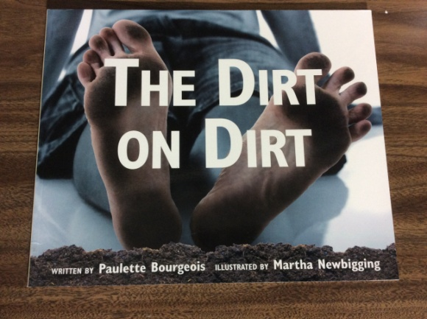
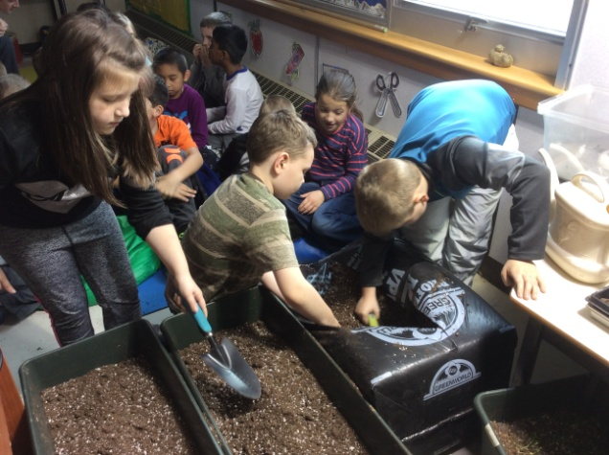
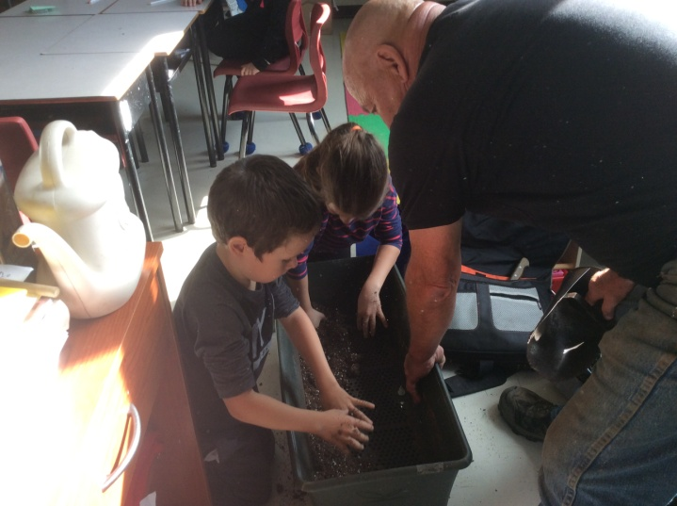
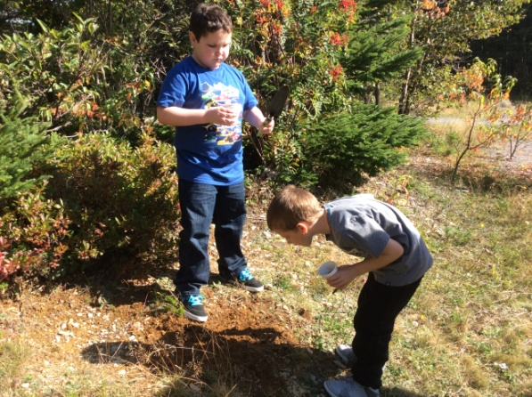
I Wonder????
Soil

Slide 39
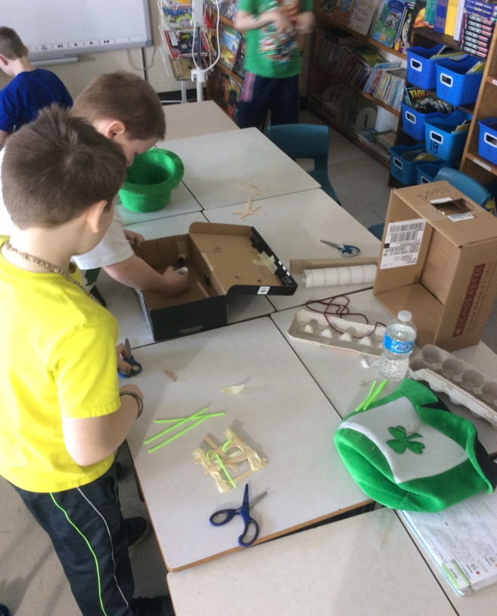
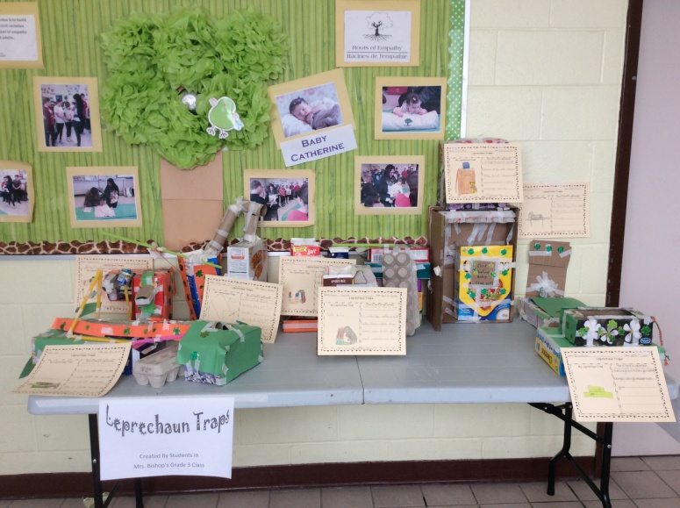
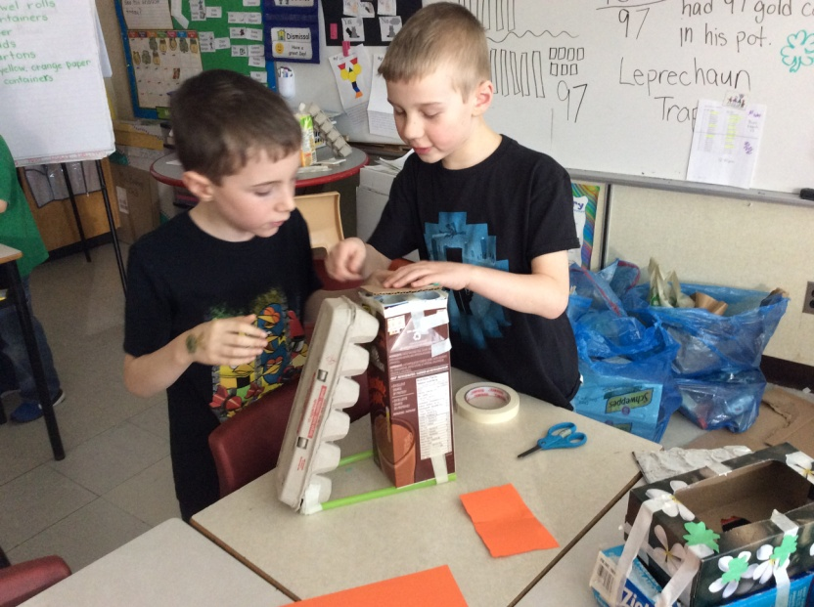
Engineering Design Challenges
Leprechaun Traps

Slide 40
Engineering Design Challenges
Design a Useful Object

Slide 41
Engineering Design Challenges
Design a Useful Object

Slide 42
Engineering Design Challenges
3 Little Pig House Design

Slide 43
Engineering Design Challenges
Rosie Revere - Rosie Copters!

Slide 44
Engineering Design Challenges

Slide 45
Engineering Design Challenges
Papa’s Mechanical Fish

Slide 46
Data Collection and Analysis
Data was collected from a variety of sources. We conducted pre and post surveys, vocabulary inventories, interviews and individual student visual representations. These were analyzed for trends.
We examined our classroom observations, videos and photographs of all math and science based activities. Evernote reflections were reviewed. Student work samples as well as their engineering designs and actual prototypes were included in our assessment of learning.

Slide 47
Results
14 Grade One students were randomly surveyed in
February 2016 and May 2016.
21 Grade Three students were randomly surveyed in
February 2016 and May 2016.
Surveys said……..

Slide 48
Results
I believe the strongest shape is
Pre-Survey Post Survey
Grade One 14% triangle 50% triangle
Grade Three 5% triangle 81% triangle
Findings:
Only three students in the Pre-Survey stated that the triangle was the strongest shape.
Other Grade Three responses included square, rectangle, circle, sphere, hexagon, cube and hectagon?.

Slide 49
Results
In science, I like to work :
a) on my own b) with a group c) both
Grade One
Pre-Survey Post Survey
7% on my own 29% on my own
43% others 29% others
50% both 42% both
“ Sometimes I like to work alone because it is less distracting.”
“ Alone gives me time to think.”

Slide 50
Results
In science, I like to work :
a) on my own b) with a group c) both
Grade Three
Pre-Survey Post Survey
14% on my own 14% on my own
38% others 29% others
48% both 57% both
One student who answered “both” in the Post Survey said, ”Depends on the activity, Miss”.

Slide 51
Results
Where / when do you use science?
a) classroom b) classroom and home c) many places
Grade One
Pre-Survey Post Survey
14% classroom 14% classroom
29% classroom and home 29% classroom and home
57% many places 57% many places
Findings:
No change in Grade One.

Slide 52
Results
Where / when do you use science?
a) classroom b) classroom and home c) many places
Grade Three
Pre-Survey Post Survey
43% classroom 19% classroom
14% classroom and home 19% classroom and home
38% many places 62% many places
Findings:
One student replied in the Pre-Survey that he “never did science before”. Post Survey results showed a significant change. More students now recognize that they use science not just in their classroom but in a variety of places beyond their school and home.

Slide 53
Results
Do you like to fix things?
Grade One
Pre-Survey Post Survey
93% yes 93% yes
7% no 7% no
Findings:
No change in Grade One.

Slide 54
Results
Do you like to fix things?
Grade Three
Pre-Survey Post Survey
76% yes 86% yes
24% no 14% no
Findings:
There was a 10% increase in students who liked to fix things in Grade Three.

Slide 55
Results
I think science is...
Grade 1
Pre-Survey
Most responses were doing experiments, making potions and making medicines.
“Science is making your brain smarter.”
Post Survey
Most references were to their feelings about science and not what science actually was.
“Science is the way you learn to make something, how it happens and how it gets created.”

Slide 56
Results
I think science is...
Grade 3
Pre-Survey
Many references were to making potions and medicines together and to activities in our classrooms like the Candy Corn experiment, Project Groundhog and to our gardens. There were a few children who answered “don’t know”.
“Science is about the class doing experiments, “I Wonder” activities, the weather and Project Groundhog and our plants.”
“Science is like medicines, liquids, seeing if things float, Candy Corn experiment, the garden and “I Wonder” activities.”
“Science is when people try new things and experiment, find, discover and make new chemicals, medicines and find out things about their world.”

Slide 57
Results
Post Survey
Many references were more specific and most responses included doing experiments, finding answers to questions, solving problems, learning about the world and doing research.
“I think science is something that you wonder about and you need to ask questions about. You can’t give up if it doesn’t work, you always keep trying.”
“Science is solving mysterious problems by doing experiments.”
“Science is when you do experiments, wonder about things, ask questions and research to find answers.”
“Science is when you try new things to see if it will work and if not you try again.”

Slide 58
Results
What is a scientist? What does a scientist do?
Grade 1
Pre-Survey
Most responses indicated a reference to a “mad scientist”.
“Somebody that makes experiments. He makes brains and a big volcano that can blow up everything.”
Post Survey
Most students indicated that scientists do experiments, measure things, solve problems and testing things to see if they can make it better. References to a “mad scientist” were less.
“Scientists are someone who studies and looks at fossils, there is a type that is an archeologist, they study things, look at the change of weather and make medicine.”

Slide 59
Results
What is a scientist? What does a scientist do?
Grade 3
Pre-Survey
The majority of students knew that scientists were people who were involved in science that included making potions, making medicines, cure diseases, do research and help people. It should be noted a few did not know what a scientist was. There was also a portion of students who referred to scientists as “he”.
“A scientist is someone whose job it is to do science. Scientists make chemicals, new medicines, they do research on things in the world.”
“There are different kinds of scientists. They are all people, some figure out how to cure diseases, some figure out about the weather or other things in the world.”

Slide 60
Results
Post Survey
The majority of students knew scientists were people involved in science. The responses to the work they do referred to doing experiments, finding answers, solving problems, and making medicines.
“A scientist. That is a person who studies science, solves problems, does experiments, makes cures and medicines to help others.”
“A scientist is a person who tests things to see how things work. They tell how things were invented or why they exist.”
“A person who does lots of experiments. If they fail they keep trying. Scientists explore the world to find answers.”

Slide 61
Results
I think engineering is...
Grade Ones did not ask this question.
Grade 3
Pre-Survey
Answers involved different topics. The most common responses included building things, fixing things, fixing cars, trains and engines. Several students did not respond or did not know.
“All about working on stuff that scientists cannot do, maybe like to work on trains, train engineers, or car engineers or boats and planes.”
“I think it is building things and plans and making sure structures are safe.”

Slide 62
Results
Post Survey
The most common responses included building things, fixing things and creating things. Students now included references to making things better such as buildings, bridges, structures, houses, playgrounds, cars and computers. All students surveyed provided a response.
“Engineering is when things are built, fixed or changed.”
“Engineering is building different things and structures, fixing them and this also makes the world a better place.”
“Engineering is designing and building all the things we use today like chairs, bikes, cars and houses.”
“Engineering is like in the old days we didn’t know how to make cars but now we do. It’s about inventing things.”

Slide 63
Results
What is an engineer? What does an engineer do?
Grade 1
Pre-Survey
Most answers involved building things and fixing things.
“Someone who designs stuff, my Poppy was an engineer, makes trains and fixes trains.”
Post Survey
Answers showed many students included the word “design” in their responses.
“I was an engineer when I made something at school.”

Slide 64
Results
What is an engineer? What does an engineer do?
Grade 3
Pre-Survey
Only some knew engineers were people. Most students responded that engineers make things, fix things especially cars and trains and build things. No specific “things” were named.
“An engineer is a person who fixes things, makes things and makes things better.”
“An engineer is someone who builds machines and they wear a hat and goggles.”

Slide 65
Results
Post Survey
All knew engineers were people. Students reported that engineers build things, create things, fix things, try to improve things, solve problems and invent things. Specific “things” were named: buildings, bridges, structures, clocks, computers, houses, lights, engines, iPads, phones, tractors, hospitals and lights. There was also specific reference to some types of engineers such as software engineers and electrical engineers. A common theme was that engineers never give up.
“An engineer is a person who fixes things, makes new things, builds things.”
“Engineers work hard and never give up. If something does not work they try to make it better.”
“Engineers try to improve things and solve problems for other people to make things easier.”

Slide 66
Results
What do you like about science?
Grade 3
Pre-Survey
Most students responded positively and liked science. The most common responses as to why they liked science were doing things and doing experiments like the candy corn, gingerbread, “I Wonders”, meal worms and our garden.
“I like science because we test and try things and do experiments.”
“I like science because you can work in a group with your friends and do science experiments.”

Slide 67
Results
Post Survey
Most students responded positively and liked science. The responses were similar to our pre-survey results but now included references to building things.
“I like science because it is fun and there is lots to do and make.”
“I like that there is usually an answer to be found. You can find out really cool stuff and learn the answer.”
“I like science because I like doing experiments on things, I like to find out what happens which is very exciting.”
“I like that we do lots of fun experiments and build things.”
“Science can help solve problems.”

Slide 68
Results
What do you not like about science?
Pre-Survey
Student responses included they did not like tasting some things, some things were boring or hard, they did not like waiting for results nor taking notes.
“I do not like waiting – like with an experiment or the “I Wonder” to have to wait and see what happens.”
“I don’t like some of the things I have to try and write or do – it’s hard sometimes.”
“I don’t like some science it’s boring, like this survey.”

Slide 69
Results
Post Survey
Student responses now indicated they did not like messy things, they did not like when things did not work or it was frustrating at times. One student did not like that we did not go to the Science Lab.
“Nothing really....well it can be messy.”
“I don’t like it when things don’t work.”
“I don’t like that sometimes it can be frustrating.”

Slide 70
Results
How does science make you feel?
Pre-Survey
Most responded that science makes them feel happy or good.
Some responded negatively, one said it makes them feel bored and a few others said “it makes me feel like - I don’t know,” or “I don’t know, I have never done it before”.
“It makes me curious in a good way.”
“It gives me ideas and questions to ask.”
“Science makes me feel really happy, we get to test and try stuff out!”
“It makes me feel happy! It’s fun!”

Slide 71
Results
Post Survey
Most responded that science gives them positive feelings such as happy, good, fun, cool, excited, and curious.
2 responded somewhat negatively, one said it makes them feel okay and another said, “I don’t know how it makes me feel”.
“It makes me feel fun and happy! I enjoy it!”
“Science makes me feel cool, like a real scientist!”
“It makes me feel excited!”

Slide 72
Results
What can we use to join things?
Grade One
Pre-Survey
Limited student responses. Only glue and tape were referenced.
Post Survey
Students were now able to give a wide variety of accurate responses such as pipe cleaners, string, ribbon, nails, glue, Legos, twist ties, hugs, needle and string, duct tape, wire and hot glue.

Slide 73
Teacher Inquiry
We began this project with various levels of experience in and knowledge of teacher inquiry. We needed time to plan, read, discuss, share, prepare and reflect on our teaching and learning. Just like student learning, teacher learning needs many varied opportunities. As we worked through activities and design challenges we became more knowledgeable and confident in specific skills. These included the scientific method and the engineering design process, promoting questioning on many levels, observation skills, encouraging investigative behaviour, teaching/facilitating student collaboration and teamwork.
Students need to learn science, engineering and math through many direct experiential opportunities that have a familiar routine structure. Students need to be supported and encouraged in a variety of ways by the teacher.

Slide 74
Project Success
Students are certainly making connections to the real world. Students are wondering about how things are made, how everyday objects might be improved and about science and engineering as future careers. We see and hear the students applying the “engineer’s attitude” in their daily lives.
Engineering is an area in which all primary students can learn and succeed.
Engineering is motivating and engages all students regardless of their age and abilities.

Slide 75
Project Success
We implemented many different activities and challenges over several months that involved all students to “learn by doing together”. We facilitated engagement, exploration/engineering, explaining, elaboration and evaluation through a consistent structure. We supported all students to experience failure as an opportunity to embrace a new challenge. They learned about persistence, patience and never giving up. We had lots of fun!
Learning by doing
–very powerful!
- so much fun!

Slide 76
Future Plans
All teachers will continue to use inquiry based teaching and learning, the Engineering Design Process and quality children’s literature within their classrooms.
Two teachers have submitted a STEM proposal for 2016- 2017.

Slide 77
References and Credits
Special thanks to :
Thomas Walsh
Professor Karen Goodnough, Ph.D
Craig Adams
Memorial University of Newfoundland
Hibernia Management and Development Company Ltd. (HMDC)
Farmer Bob
St. Matthew’s School – Administration and Staff
Our students and their families
Ourselves

